Slide 1
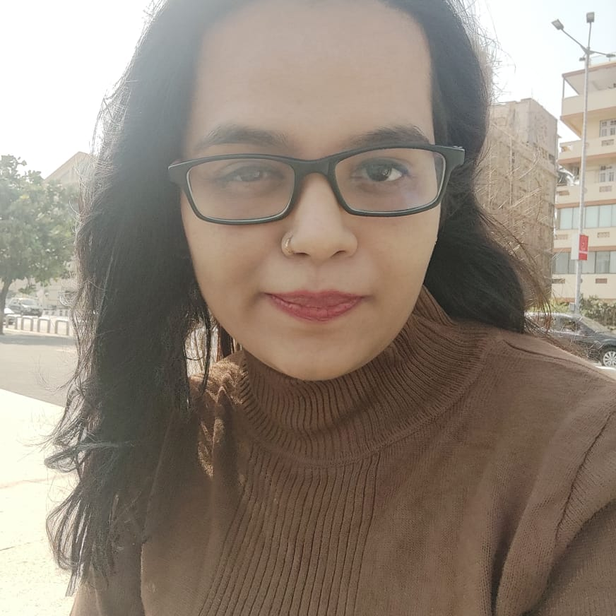
Bithi Talukder
Sr.Analyst/Software Engineer
Master of Technology,
Information Technology
Engineering : 2020-2022
Mumbai
bithi.talukder@capgemini.com
Skills:
8276964212
C# | Basics, OOPS, Exception Handling ,Arrays ,Collection and Generics.
.NET Framework | ADO.NET, .NET 6 WEB API, Entity Framework , ASP .NET with MVC5.
Database | SQL ,
Tools | GIT, Swagger
UI Technology | HTML5 ,CSS & Angular
Add On Skills | Communication Skills, Team Management
A5
Full Stack developer with Angular and .NET.
• Hands on experience on C#,ADO.NET, Entity framework , SQL Server , ASP.NET MVC5 with WEB API and in creating services with .NET Framework.
• Proficient in creating Single page Web Application in Angular with Authentication with routing. Hands on experience in developing web pages using HTML5, CSS3, Object Oriented, TypeScript. Good understanding of Document Object Model (DOM) and DOM Functions.
• Experience in creating documentation with swagger
Developed a WEB APPLICATION as part of case study using .NET WEBAPI , & ANGULAR.
Experience
Roll Off Project:
Develop a project which helps to Roll off the employee. This project should act as a communication among Accounts team, PSP and admin. We make a web application that automates and minimize the time off roll off process via email. Roll off must be shared within 30 days of notice period along with the complete details. In this application we can ensures that if employee are on probation and there is performance issue the respective Roll Off will not be considered.
Github Link
Tool Used:
Visual Studio 2022 & VS code

